Slide 1
Elephant Movement in Kaudulla
What the Data Tells Us
Statistical Consulting Service
Department of Statistics, Faculty of Applied Sciences
University of Sri Jayewardenepura, Nugegoda, Sri Lanka

Slide 2
What This Project Is
The Department already collars and tracks elephants in Kaudulla. This project turns that existing GPS data into patterns the raw records do not show.
1
Monitoring missing data
2
Analysis of elephants' movements
What we did with the data
3
Climate and vegetation data analysis
4
Checking elephant movement anomalies
2 / 7

Slide 3
The Data We Worked With
# | Dataset | Time resolution | Period | Size
1 | Elephant GPS tracking | Hourly | Jul 2024 – Jun 2026 | 16,747 records, 15 elephants
2 | Climate | Monthly | 2017 – 2025 | 9 variables × 9 years
3 | NDVI vegetation classification | Annually | 2018 – 2026 | 5 density classes
3 / 7

Slide 4
Variables Used from Each Dataset
1
GPS Tracking
2
Climate
3
NDVI Vegetation
Hourly
Monthly
Annually
collar_id — collar number
name — elephant name
sex — male / female
date — date of fix
time — time of fix
lat — latitude
lon — longitude
PRECTOTCORR — precipitation, corrected (mm)
T2M — temperature at 2 metres (°C)
% cover by density class:
non-vegetation, shrubs & degraded grasslands, sparse or stressed vegetation, moderate canopy coverage, high density forest
% cover by plant health:
very healthy, moderately healthy, unhealthy
4 / 7

Slide 5
Dataset 1: GPS Tracking Data
15
1 elephant removed — Vidusha (collar 6184)
elephants collared
Only one GPS record in the entire file, and that single position (10.91°N, 81.70°E) falls outside Sri Lanka. Movement cannot be measured from a single invalid point.
16,747
raw GPS records
The 14 elephants analysed
Gothami
Dewmi
Kasun
14
Recollared female
Dona
Illuk
elephants used for analysis
Mina
Tara Devi
Pazhani
After cleaning: 16,735 valid GPS records across 14 elephants.
Talatha
Rahu
Damien
female_1
Wilmini
5 / 7

Slide 6
Cleaning Criteria Applied to the Tracking Data
# | Criterion | Rule applied | Why | Removed
1 | Name correction | Collar 6165 “…” renamed female_1 | The unnamed animal needed a stable label | —
2 | Valid timestamp | Date and time must be readable | A corrupt time cannot be placed on the timeline | 0
3 | Coordinates present | Latitude and longitude not blank | No position means no movement | 0
4 | Inside Sri Lanka | Lat 5.9–9.9, Lon 79.5–81.9 | Impossible positions from poor satellite geometry | 4
5 | GPS accuracy | HDOP ≤ 10 | High HDOP means an error of hundreds of metres | 8
Total removed: 12 records out of 16,747 = 0.07%
No interpolation applied. Missing hours were left blank, not filled with estimated positions.
6 / 7

Slide 7
Data Availability by Elephant
Collar | Name | Sex | Start | End | Days | Fixes | Expected | Available Percentage
6119 | Pazhani | F | 2025-09-07 | 2025-09-09 | 2.0 | 50 | 50 | 100.0
6182 | Damien | M | 2025-09-08 | 2025-09-09 | 0.6 | 15 | 15 | 100.0
6156 | Wilmini | F | 2024-10-16 | 2024-10-22 | 6.5 | 131 | 157 | 83.4
6123 | Rahu | M | 2025-10-20 | 2025-11-13 | 24.0 | 357 | 577 | 61.9
6155 | Gothami | F | 2024-08-23 | 2025-11-11 | 444.9 | 5,373 | 10,678 | 50.3
6129 | Kasun | M | 2025-07-13 | 2025-07-30 | 18.0 | 193 | 432 | 44.7
6121 | Recollared female | F | 2024-08-25 | 2026-06-17 | 660.9 | 5,127 | 15,862 | 32.3
6165 | female_1 | F | 2024-08-23 | 2025-07-23 | 334.0 | 2,354 | 8,018 | 29.4
6144 | Illuk | M | 2025-06-22 | 2025-07-20 | 27.9 | 87 | 671 | 13.0
6139 | Mina | F | 2024-07-14 | 2025-10-27 | 470.0 | 1,045 | 11,280 | 9.3
6114 | Talatha | F | 2024-07-18 | 2025-10-27 | 466.2 | 853 | 11,191 | 7.6
6131 | Dona | F | 2024-09-09 | 2025-08-06 | 331.0 | 464 | 7,946 | 5.8
6154 | Dewmi | F | 2024-11-09 | 2025-11-28 | 384.0 | 451 | 9,216 | 4.9
6179 | Tara Devi | F | 2024-07-22 | 2025-10-09 | 443.9 | 235 | 10,654 | 2.2
7 / 7

Slide 8
Movement Analysis of Elephants
Kaudulla Elephant Movement Study
5

Slide 9
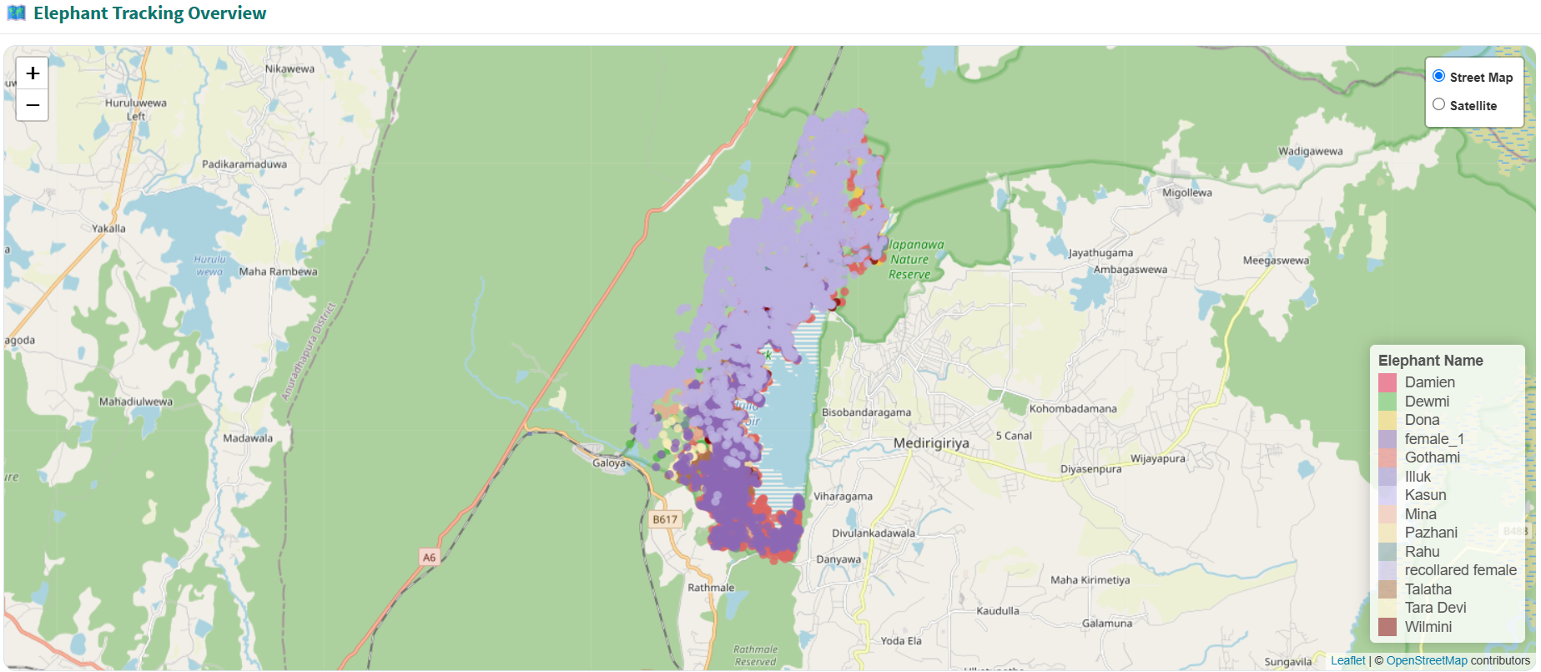
Landscape-Level Movement
All tracked elephants use a common landscape centered around the Kaudulla Reservoir, with many also moving towards the Ralapanawa Nature Reserve.
Kaudulla Elephant Movement Study
1

Slide 10
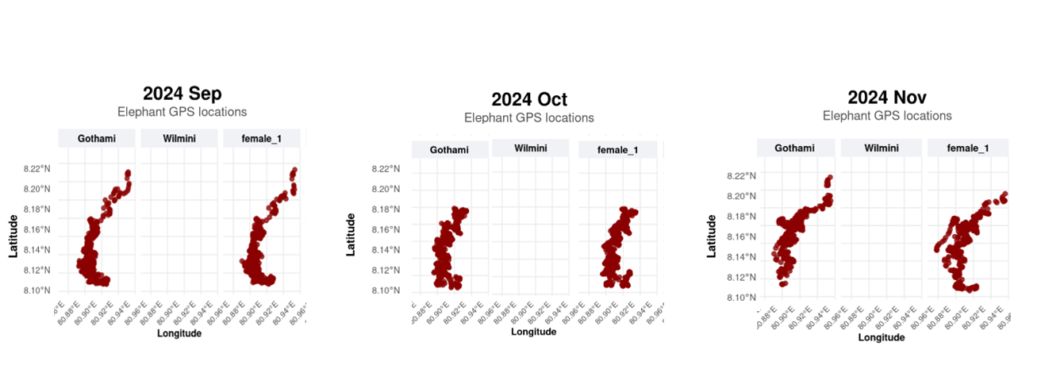
Movement Pattern Observation
An interesting observation is that Gothami and female_1 show very similar movement patterns during September, October, and November 2024.
Kaudulla Elephant Movement Study
2

Slide 11
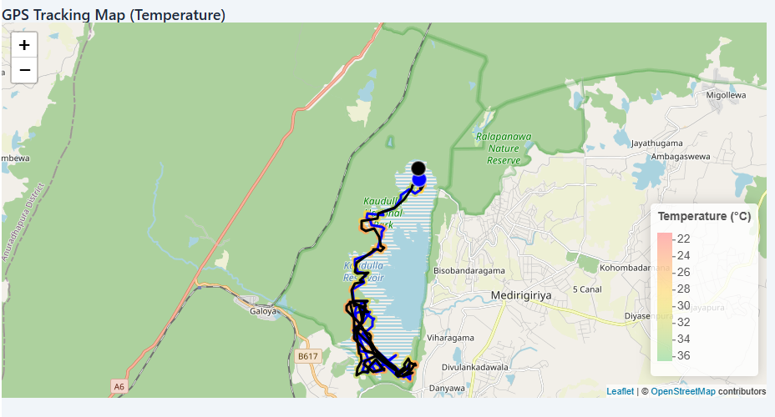
Kaudulla Elephant Movement Study
3

Slide 12
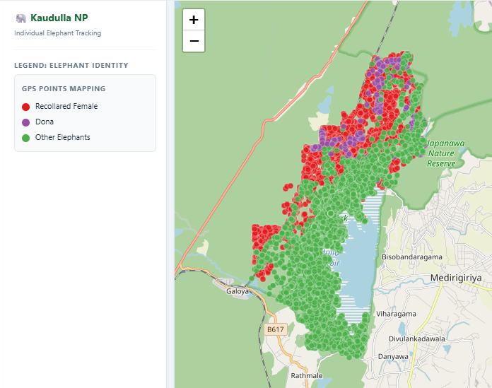
Movement Pattern Observation
Dona mainly stayed in the northern part of the park, while Recollared_Female showed a unique pattern with frequent visits to both the railway track area and the upper region.
Kaudulla Elephant Movement Study
4

Slide 13
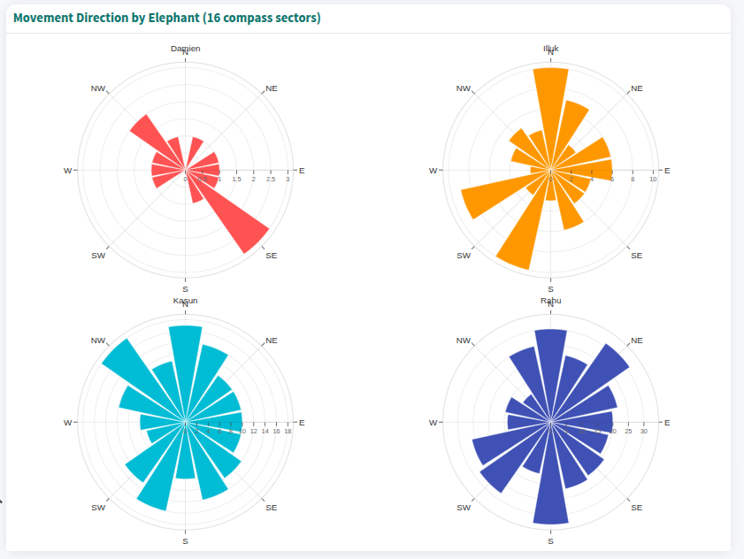
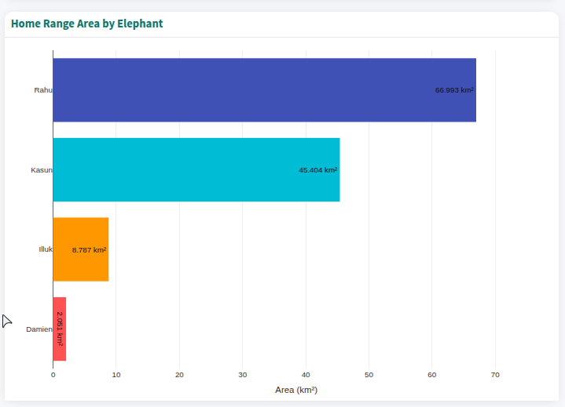
Kasun and Rahu demonstrated the widest directional movement, whereas Damian and Iluk followed more focused movement routes, indicating individual differences in space use.
Kaudulla Elephant Movement Study
6

Slide 14
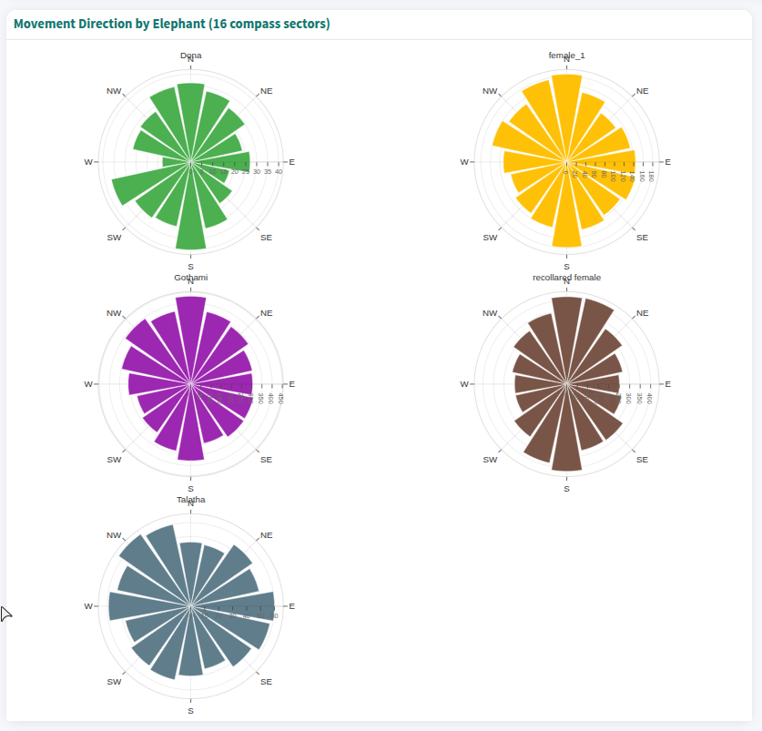
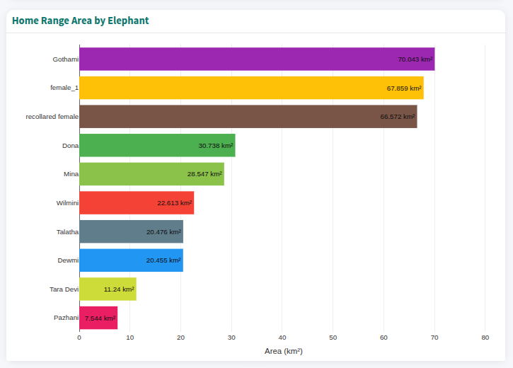
Female elephants displayed balanced movement in nearly all directions, suggesting widespread use of available habitat with only minor variation in directional frequency.
Kaudulla Elephant Movement Study
7

Slide 15
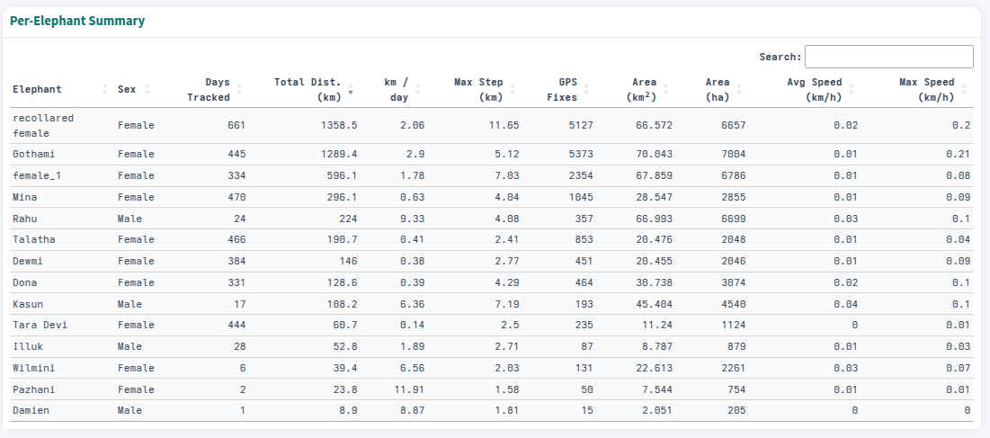
The per-elephant summary table provides an overall comparison of tracking duration, movement, home range size, GPS data availability, and movement speed for each elephant, allowing individual movement behavior and space-use patterns to be compared across the study population.
Kaudulla Elephant Movement Study
8

Slide 16
Movement Analysis with Climate & Vegetation Data
Kaudulla Elephant Movement Study
9

Slide 17
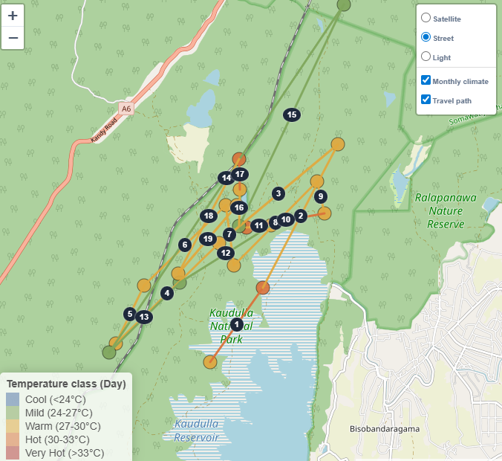
Climate-Driven Spatial Patterns of the Re-collared Female
Her movement pattern indicates that she tends to stay farther from the reservoir during periods of lower daytime and nighttime temperatures. But for hot (higher) temperature periods she doesn’t show any specific pattern.
Kaudulla Elephant Movement Study
10

Slide 18
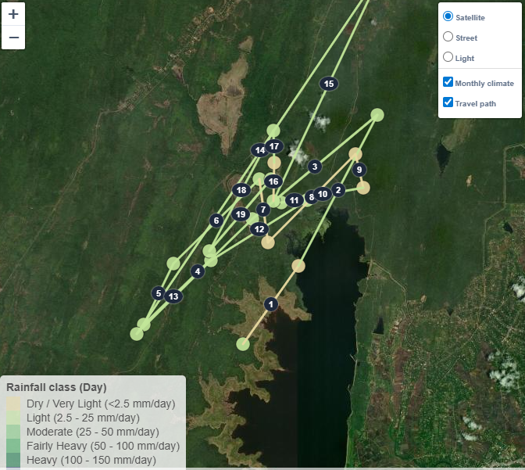
Her locations in December 2024 and December 2025 were geographically very similar, with both occurring away from the reservoir. These observations were recorded under the same rainfall category, indicating consistency in habitat use under similar rainfall conditions in same period of year.
Kaudulla Elephant Movement Study
11

Slide 19
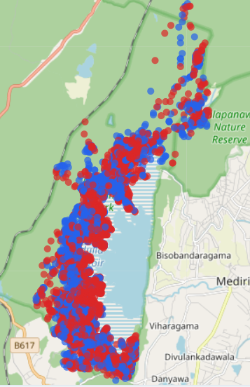
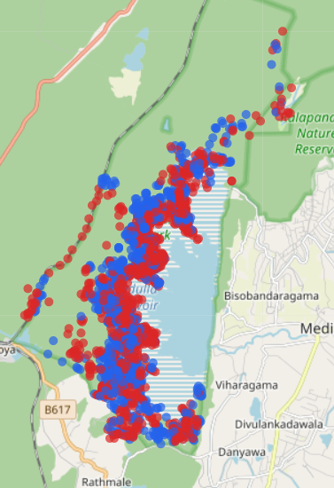
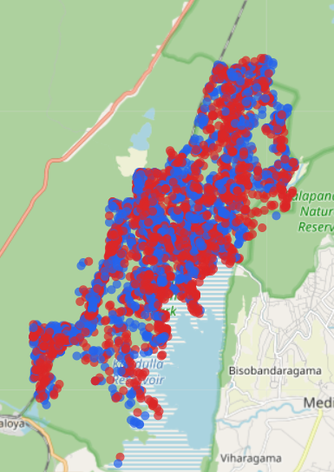
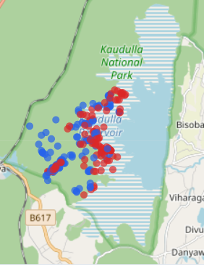
Comparison of Daytime and Nighttime Locations
Day and night GPS points overlap considerably, indicating stable home ranges rather than different day/night territories. Although elephants appear to use areas slightly further into the reservoir during the daytime than at night.
Gothami
Female_1
Recollared_Female
Tara Devi
Kaudulla Elephant Movement Study
12

Slide 20
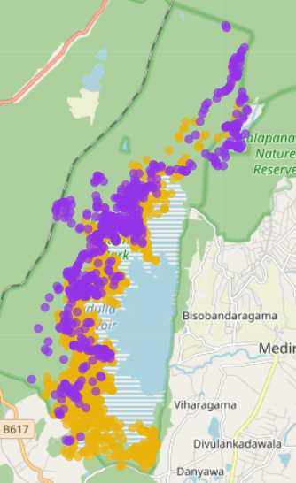
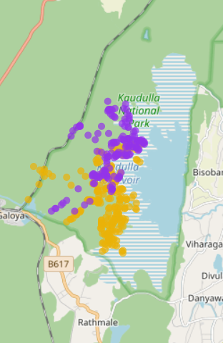
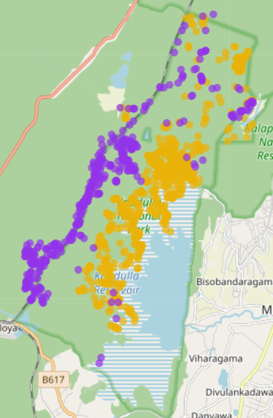
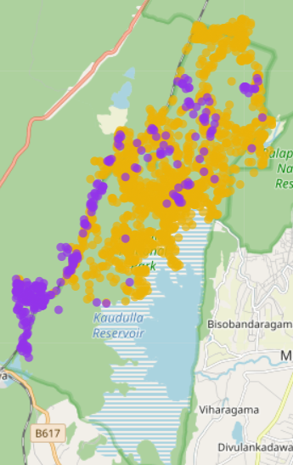
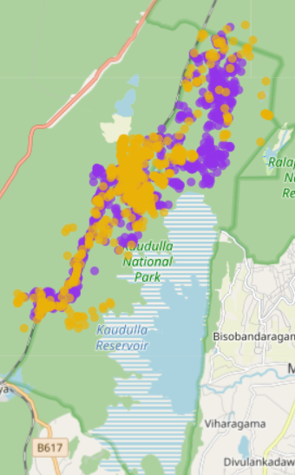
Comparison of Hot and Cool Season Locations
Some elephants, such as Gothami and Dewmi, occupied more northerly areas during the cool season, indicating that their locations were relatively more southerly during the hot season. The Recollared Female showed a distinct seasonal pattern in 2024 and 2025, with their cool-season locations shifting away from the reservoir towards the Trincomalee railway line. However, this pattern was not evident in 2026. During the hot season of both 2025 and 2026, her GPS locations appeared to be more frequently concentrated near a paddy field.
Gothami, 2024
Dewmi, 2025
Recollared female, 2024
Recollared female, 2025
Recollared female, 2026
Kaudulla Elephant Movement Study
13

Slide 21
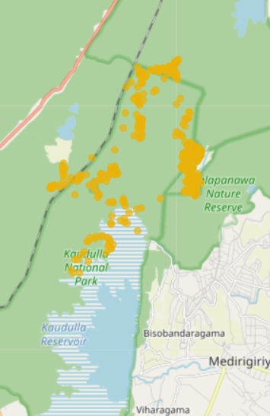
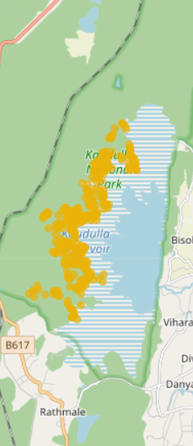
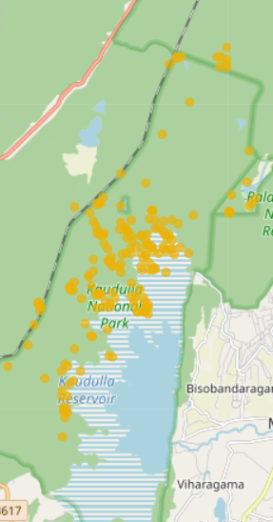
Since the dataset was imbalanced across seasons, with most elephants tracked only during either the hot or the cool season, seasonal comparisons are limited. Although a few individuals appear to shift their locations between hot and cool periods, the evidence is insufficient to draw strong conclusions about seasonal movement.
Dona
Female 1, 2025
Kasun
Kaudulla Elephant Movement Study
14

Slide 22
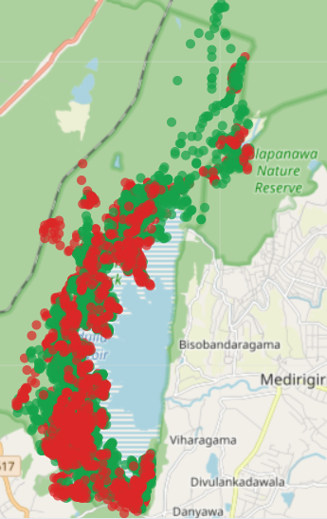
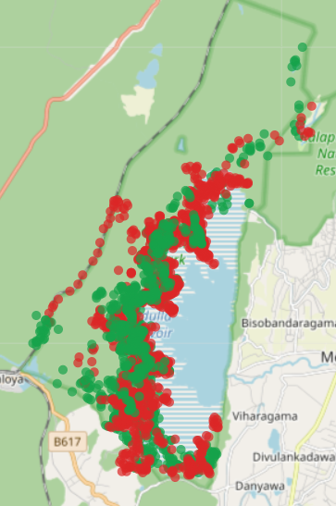
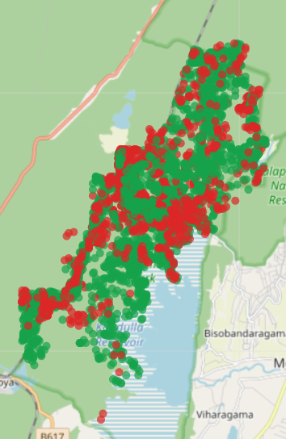
Comparison of Heavy and Low Rainfall Locations
Most elephants occupied similar areas during both heavy and low rainfall periods.
Gothami showed a slight northward shift under low rainfall conditions compared with heavy rainfall periods
Some individuals were only tracked in one rainfall condition, so comparisons were limited.
Gothami
Female_1
Recollared_Female
Kaudulla Elephant Movement Study
15

Slide 23
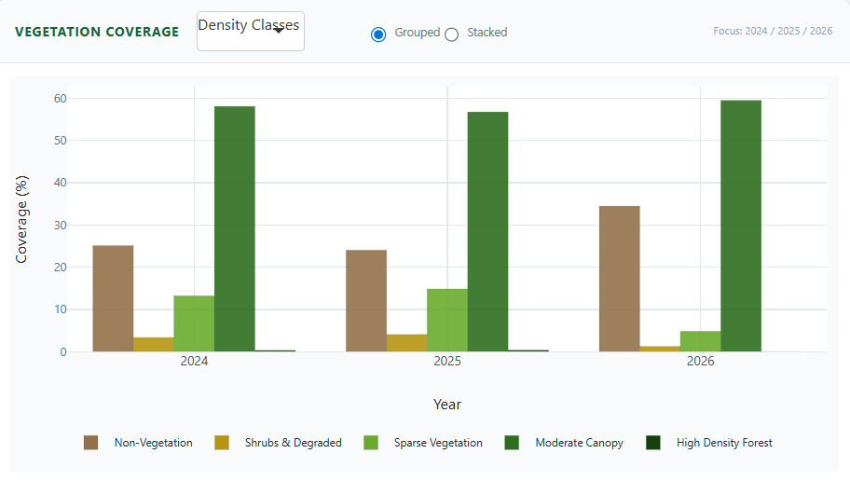
Vegetation Dynamics and Elephant Movement Patterns
Vegetation changed slightly across the three years.
2026 had the highest canopy cover, but also the highest proportion of non-vegetated land. This is the key vegetation signal that connects to elephant behavior, but 2026 data is only available for recollared female.
Kaudulla Elephant Movement Study
16

Slide 24
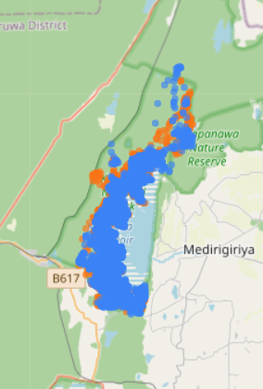
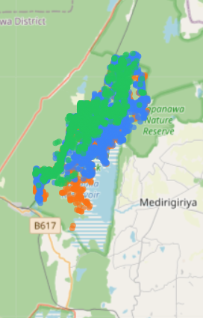
Across 2024 and 2025, most elephants exhibited stable home ranges, indicating strong site fidelity. However, the Recollared Female showed a noticeable shift away from the reservoir area in 2026 compared with 2024 and 2025.
Gothami
Recollared Female
Kaudulla Elephant Movement Study
17

Slide 25
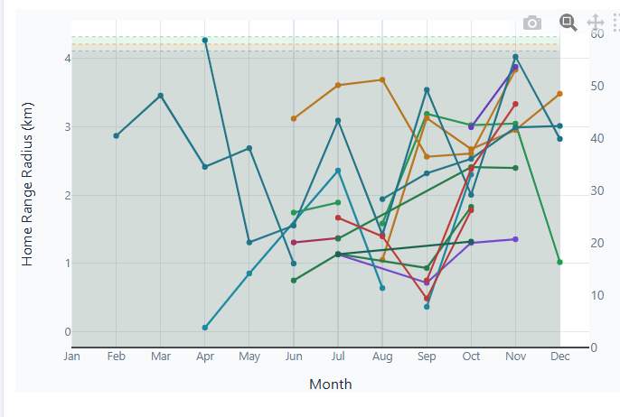
Monthly Home Range variation
The Recollared Female had the most complete monthly data and showed the widest monthly home range (4.27 km) in April 2025, at the beginning of the hot season, suggesting increased movement to locate food and water resources as environmental conditions became drier.
For the remaining elephants, monthly data were concentrated mainly between June and December. Within this period, several elephants exhibited larger home ranges around October–November.
Kaudulla Elephant Movement Study
18

Slide 26
Anomaly Detection Methods
Four ways of asking: is something wrong with this elephant?
Kaudulla Elephant Movement Study
19

Slide 27
Movement rate
1
The idea
2
Why it matters
For each elephant, sum how far it travels each day, and flag any day it covers far less ground than its own normal, down to its lowest 1% of days on record.
A sudden drop in daily movement is one of the earliest signs that something is wrong: injury, snaring, illness or weakness while the animal is still moving and can still be reached in time.
3
Judged against itself
4
Reliable only where data is dense
Every elephant is compared to its own history, never a park average so a naturally low-ranging animal is not falsely flagged, and a decline in an active one is caught early.
A day's distance is trustworthy only when most hourly fixes are present (≥ 20/day). Where a collar is sparse the method stays silent — and that silence means “not enough data”, not “the elephant is fine”.
Kaudulla Elephant Movement Study
20
Notes:
Method 2 is the movement rate module. One number per elephant per day - total distance walked. Each elephant is its own yardstick: the alert line is that elephant's 1st percentile of daily distance. Days with fewer than 20 hourly fixes are excluded, so a quiet collar never looks like a quiet elephant.

Slide 28
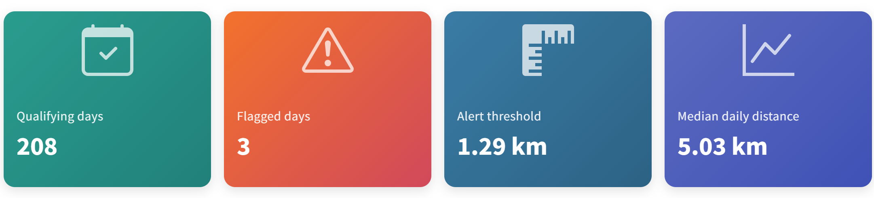
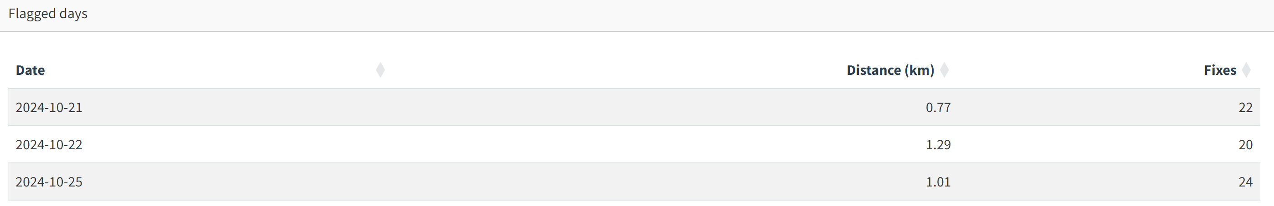
Example — Gothami
How to read it
Only 3 of 208 well-covered days were flagged and all three fall inside one week. A short cluster is a far stronger prompt than any isolated day.
On those days she moved 0.77–1.29 km, against a typical 5.03 km/day.
She resumed normal movement immediately after. This could be the elephant resting time, not an emergency, but exactly the kind of event worth a field check.
Kaudulla Elephant Movement Study
21
Notes:
Gothami: 208 qualifying days, alert threshold 1.29 km, median 5.03 km/day. Three flagged days, 21-25 October 2024, distances 0.77, 1.29 and 1.01 km on 22, 20 and 24 fixes. Normal movement resumed straight after. Caveat to state up front: this threshold is computed in-sample over her whole record, so it is retrospective rather than the prospective baseline Wall et al. use.

Slide 29
Immobility Anomaly Monitor
Immobility is the state of not moving, or being incapable of moving or changing location
Kaudulla Elephant Movement Study
22

Slide 30
Key Insights
The published rule:
flags an elephant when it stays within a 13-metre circle for 5+ hours; a pattern that means one of three things: dead, injured, or in deep rest. (Wall et al.)
The one flag — Gothami
flagged: 6 Aug 2025, 01:00–06:00 (5 hours). Gothami kept transmitting normally for months after – so this was deep rest, not death or injury.
Silence isn’t proof of safety
Most elephants are missing 55–98% of their GPS fixes, so a “no flag” result for them mainly reflects missing data, not confirmed safety.
Only Gothami and recollared female have enough data coverage to trust their result either way
Kaudulla Elephant Movement Study
23

Slide 31
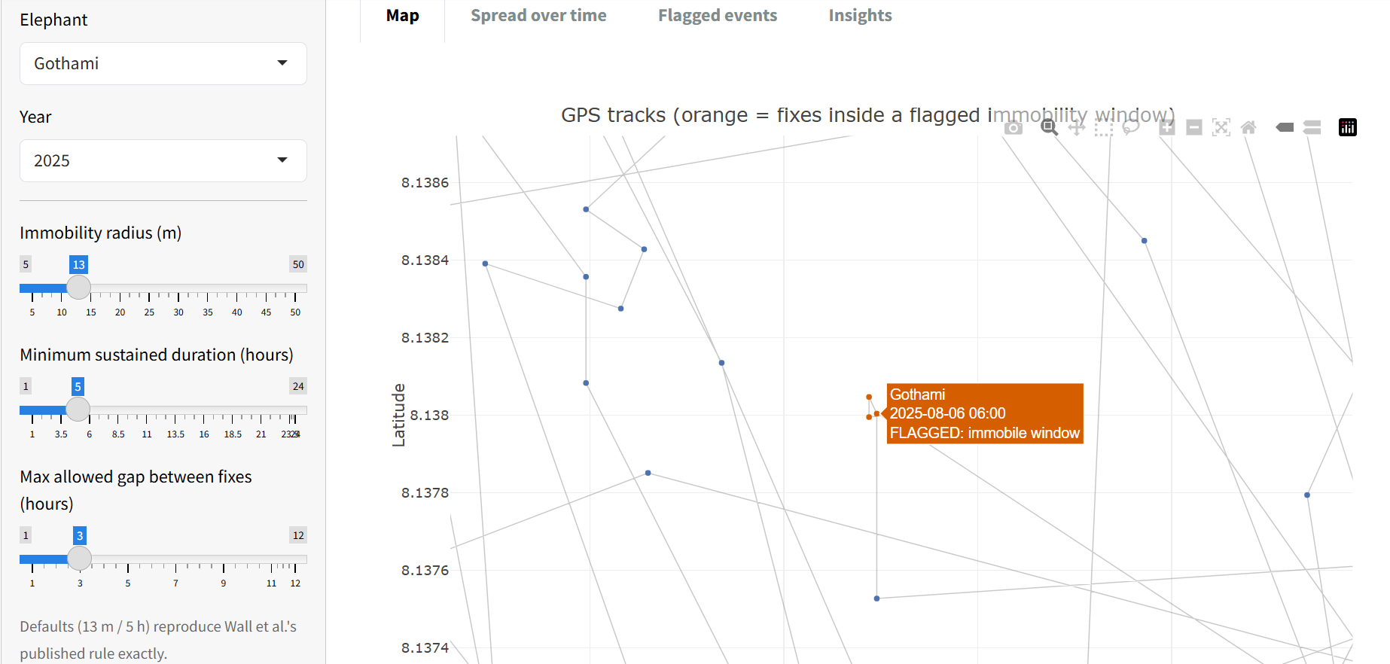
What the dashboard shows
Analytics picks an elephant, a year, and thresholds and the map highlights any GPS fixes that fall inside a flagged immobility window.
Kaudulla Elephant Movement Study
24

Slide 32
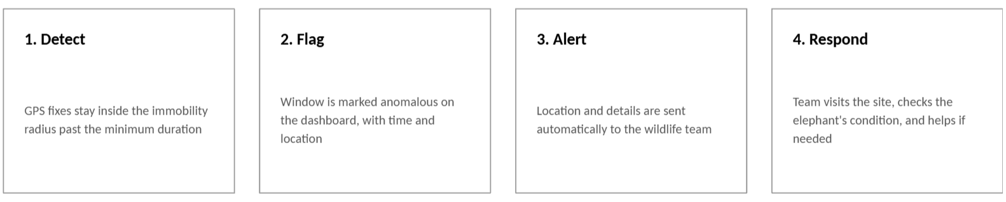
Elephant Recue Alert System
When unusual elephant behavior is detected, the system sends an alert with location to the wildlife team. They can visit the location, check the elephant’s condition, and provide help if needed. This allows faster action can improve the elephant’s survival.
Kaudulla Elephant Movement Study
25

Slide 33
Proximity Anomaly Detection
Proximity & Separation Analysis of GPS-Collared Elephants
Kaudulla National Park
Statistical Consultancy — Wildlife Conservation Department
Kaudulla Elephant Movement Study
26

Slide 34
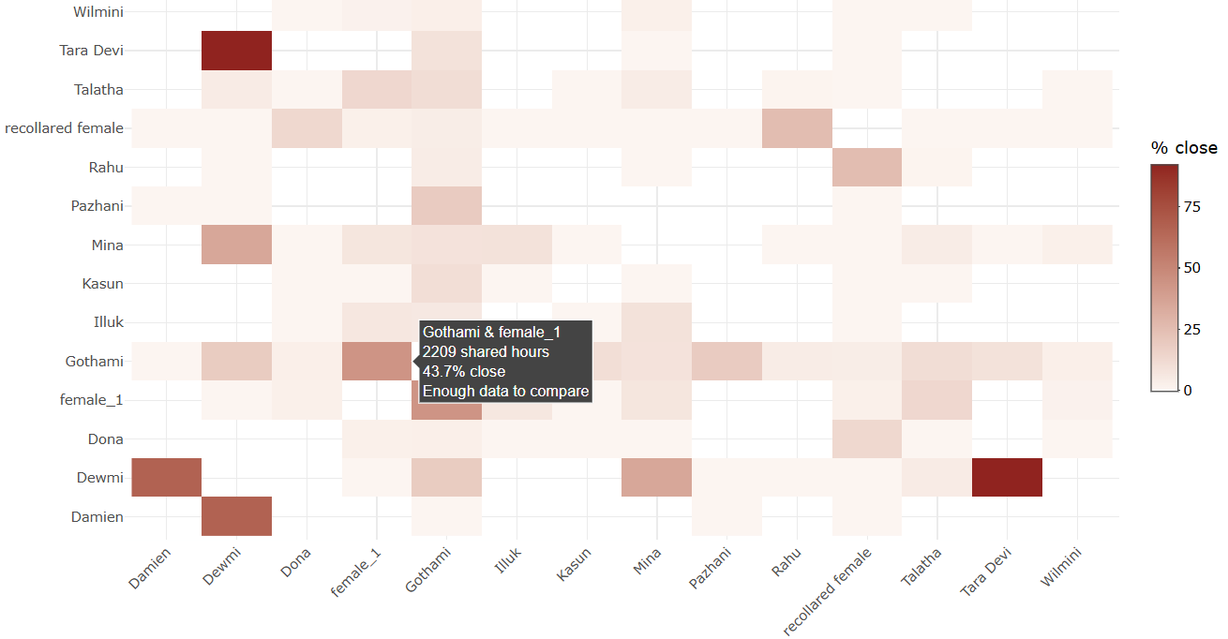
KEY INSIGHTS & DASHBOARD FUNCTIONALITY · PAIRWISE PROXIMITY
Key Insights for the Proximities Across the Herd
A CLOSE PAIR IN THE HERD
43.7%
of tracked time spent within 500 m
Gothami & female_1 · 2,209 shared hours
MOST SHARED DATA, NO RELATIONSHIP
0%
within 500 m, despite extensive tracking
Talatha & recollared female · 443 shared hours
Relationships tab — colour shows % of shared hours spent within threshold; hover any cell for exact figures.
500 m threshold set from the real spread of distances observed between collared elephants, consistent with the proximity rule used in Wall et al. (2014).
Kaudulla Elephant Movement Study
27

Slide 35
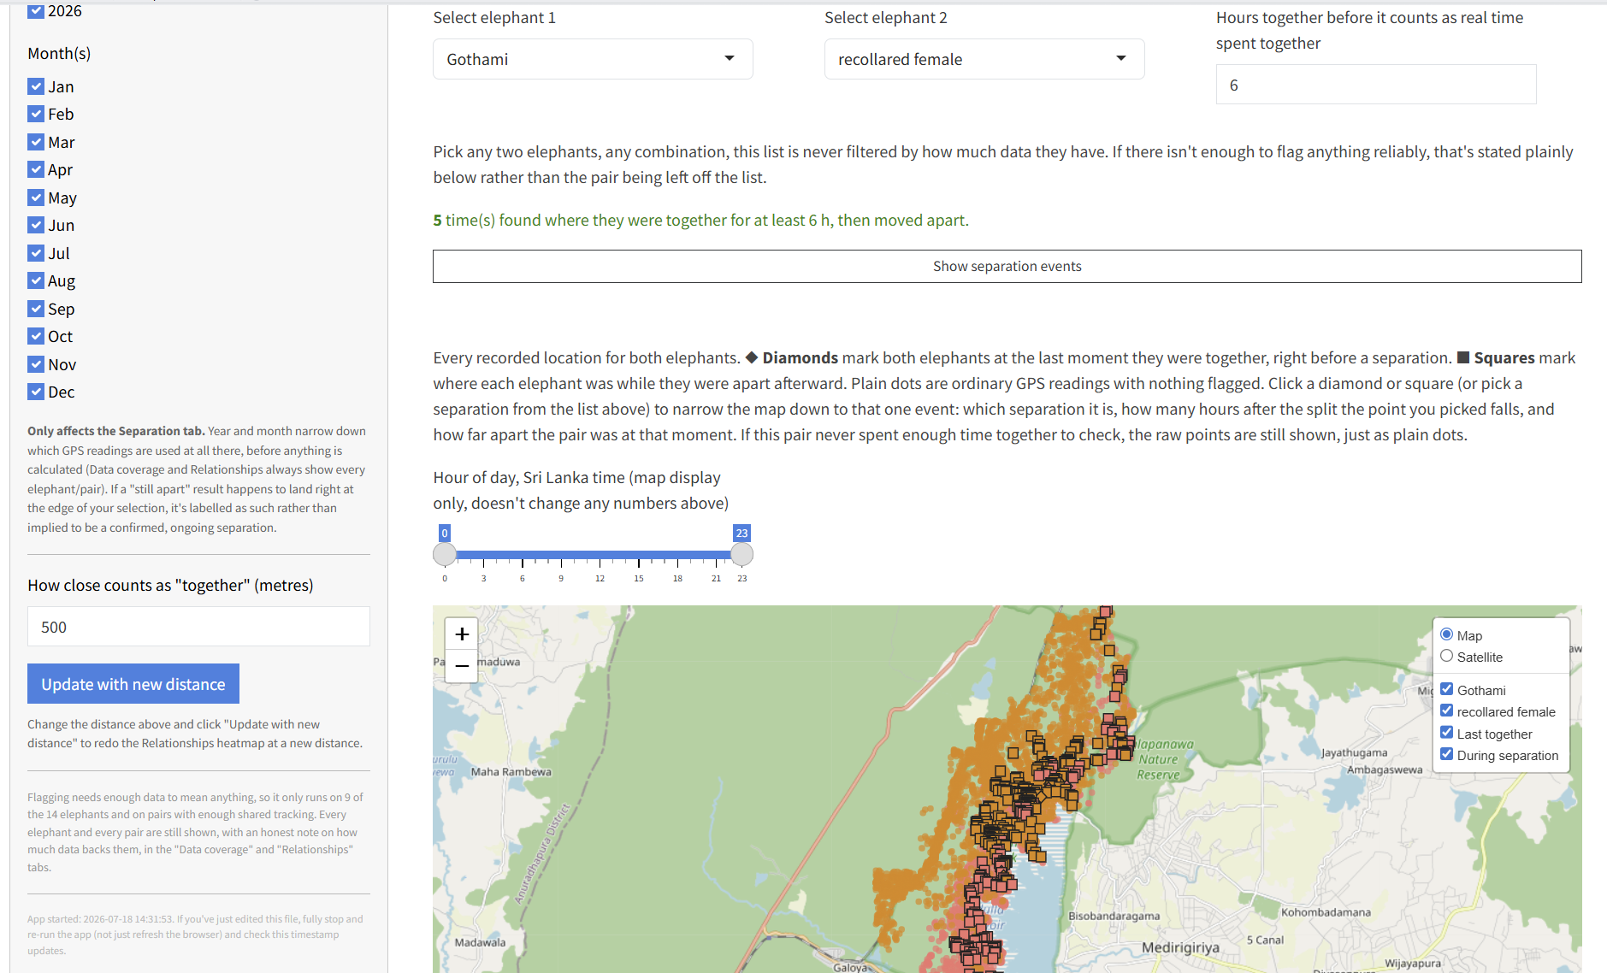
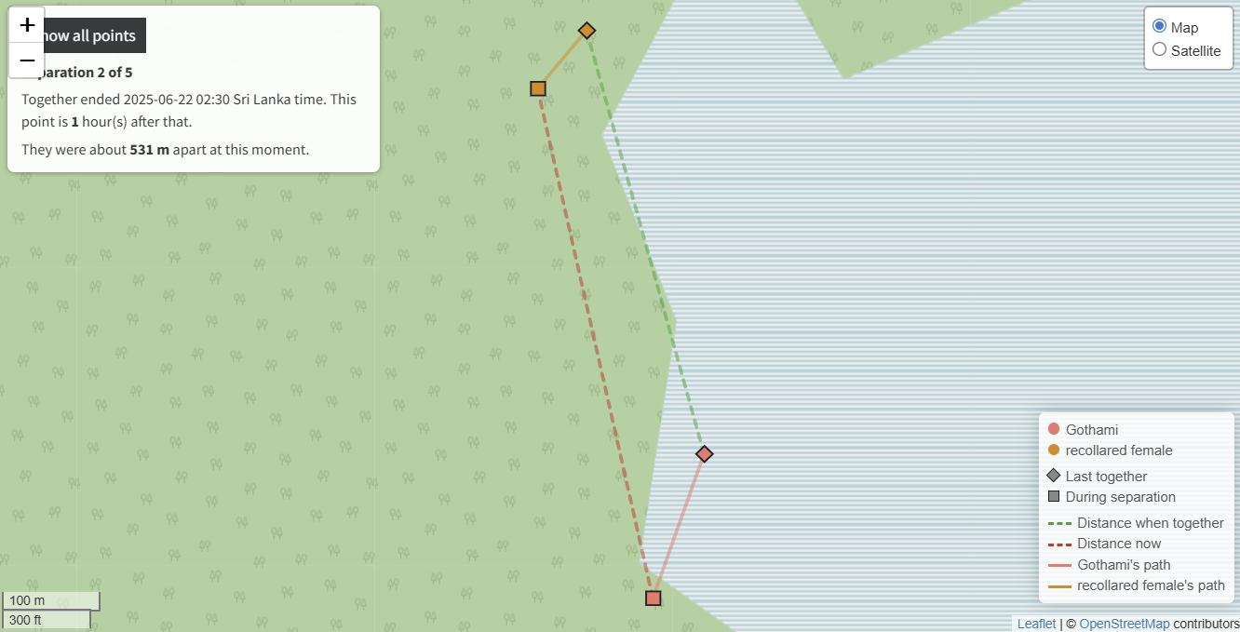
When Do They Split — And Where?
1
Select & set a threshold
2
See every separation
3
Inspect one event
Any two elephants; a distance (500 m) and minimum-hours-together threshold define “together.”
Every GPS fix is plotted — diamonds mark last-together, squares mark time apart — filterable by year, month, hour.
Click a flagged point, or jump to any listed separation by timestamp, to isolate exactly when and where.
2 of 5
1 hr
531 m
separation
after split
apart
Full separation history for the pair — every flagged point is clickable; filters apply by year, month, and hour.
Clicking narrows the map to a single event: exact timestamp, elapsed time, and distance between the pair.
Kaudulla Elephant Movement Study
28

Slide 36
Revisit Anomaly Detection
How often does each elephant come back to the same place?
Kaudulla Elephant Movement Study
29

Slide 37
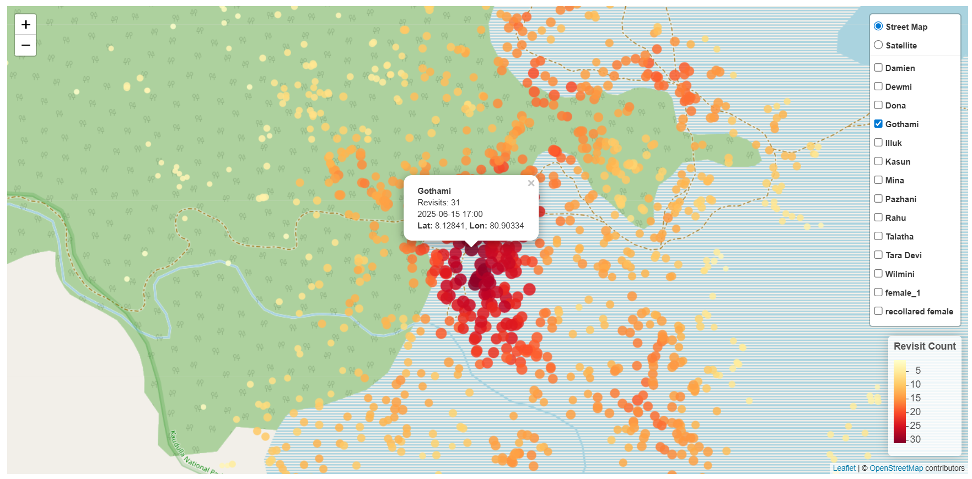
Some elephants keep returning to the same few spots
Tracking data shows most locations are visited only once — but a small number of 150-metre spots get used again and again. These aren't random points on the map. They're the places an elephant relies on, most likely water, shade, or reliable forage. The darkest-colored spots on the map are candidate priority sites for habitat protection.
31 visits
Only 4%
Gothami's top spot, over 445 days
of Gothami's locations were one-time-only
Kaudulla Elephant Movement Study
30

Slide 38
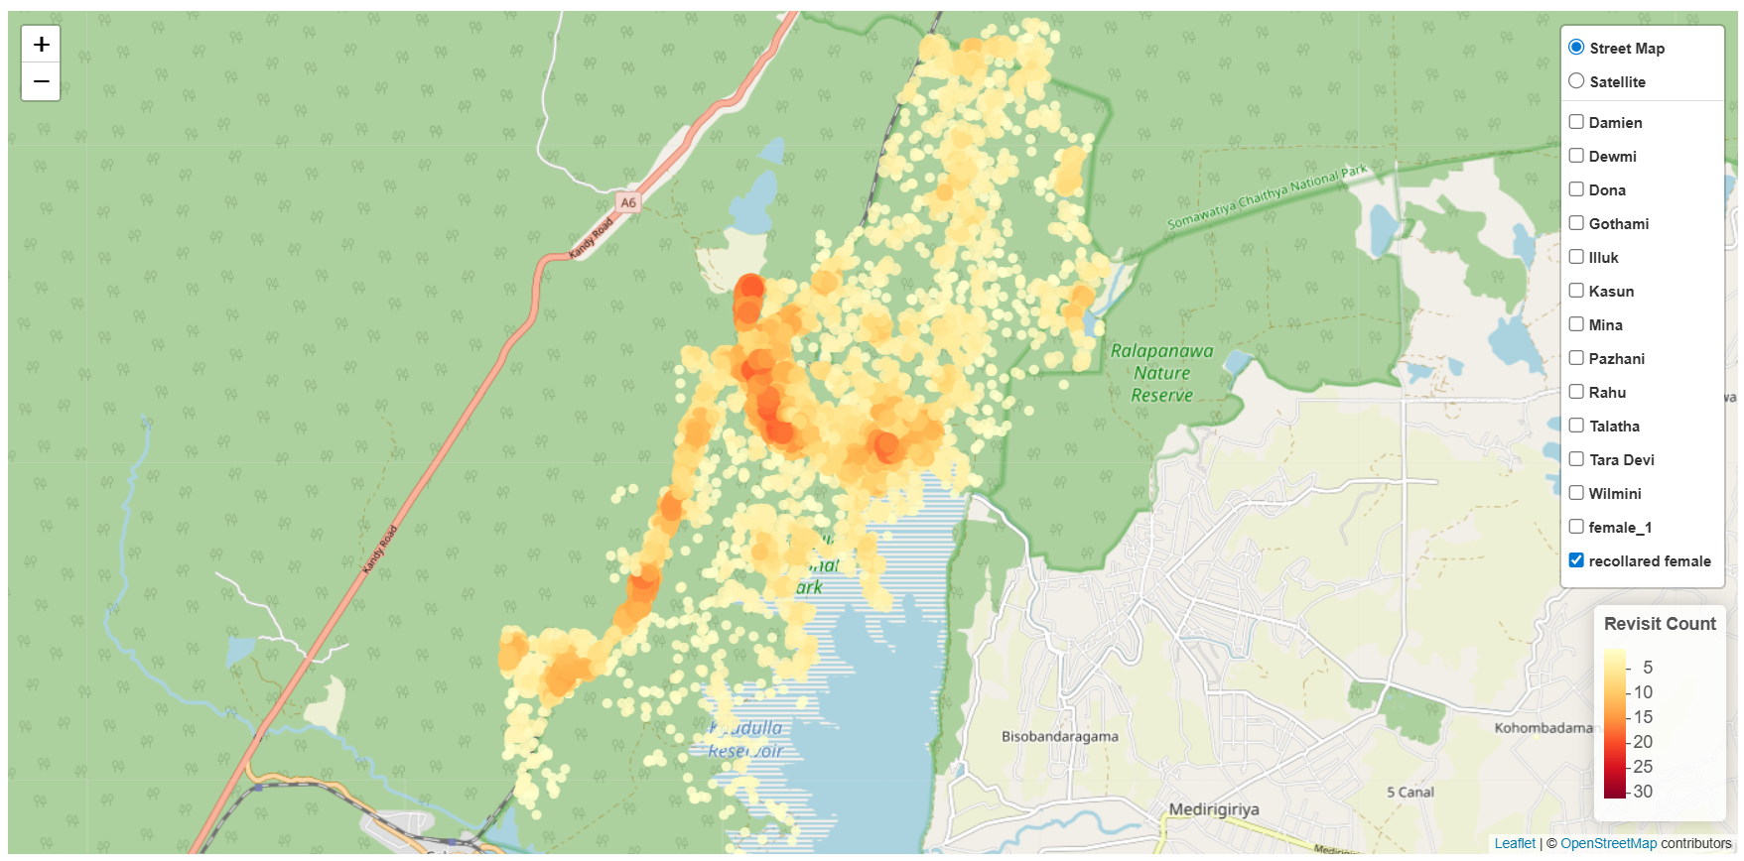
Recollared female's core area breaks from the shoreline pattern
Gothami and female_1's hotspots all trace the reservoir's edge — every dark cluster sits right on the shoreline. Recollared female is different: her main hotspot cluster sits well inland, north of the reservoir.
Up to 22
~8 km
visits at the inland cluster
north of the reservoir shoreline
Kaudulla Elephant Movement Study
31

Slide 39
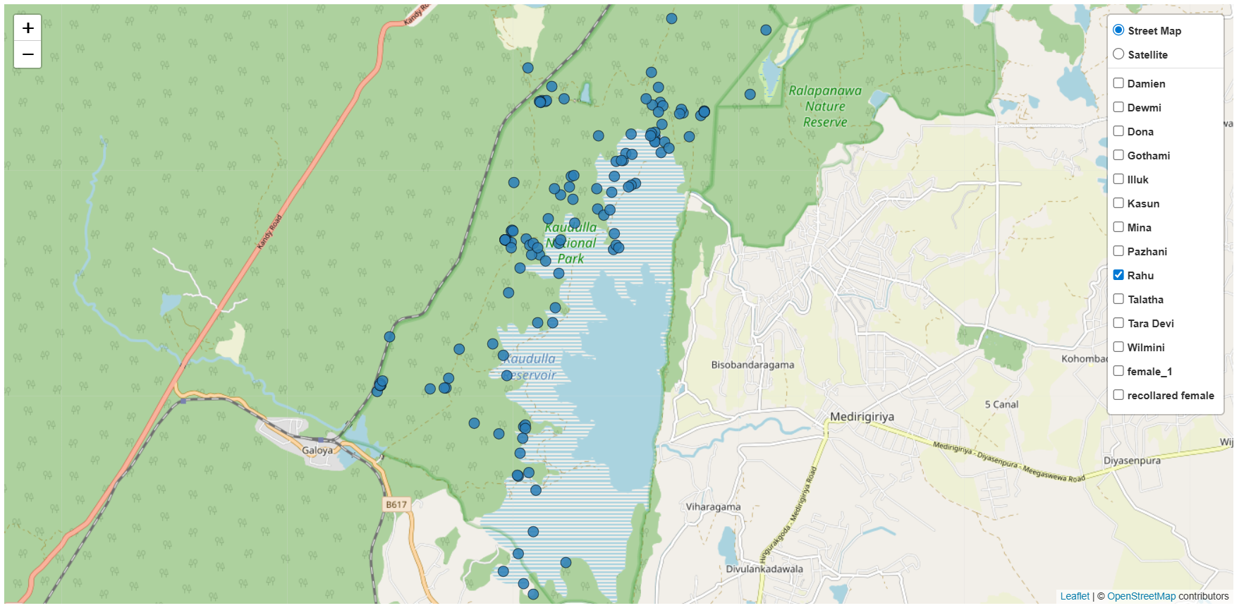
The movements of some elephants are exploratory
Not every elephant sticks close to home. Rahu's tracking shows about 41% of its locations were never revisited — a sign of long-distance or exploratory movement.
~41%
24 days
of Rahu's locations, one-time-only
tracked — read as a snapshot, not a settled pattern
Kaudulla Elephant Movement Study
32

